Slide 1

D26030: QPM Sentinel
From Hidden Signals to Explainable Sequencing Diagnostics
2026 CSD AI Hackathon Team members
Yan Zhu
Chao Wang

Slide 2
Disclaimer
Project Timeline & Hackathon Contribution
Project or idea initiated: Oct. 2026
Development duration before the hackathon: 1 week
Work completed before the hackathon: 2000+ CSA archived
Work completed during the 2-day hackathon: Trained ML models for volume transfer prediction from QPM (Qualitative Pipetting Monitoring) waveform. Trained ML models for run performance prediction from all CSA plugin metrics. Built a prototype to diagnose barcode dropout and poor performance.

Slide 3

Collaboration
Gathered internal VOC from R&D, V&V, and program/product management to understand frustrations with sample dropout and poor performance.
Partnered with Molecular Biology, Systems, Bioinformatics, and Software teams to build a prototype for root cause analysis of sample dropout and poor run performance.
Close collaboration is essential to combine biological expertise, system knowledge, and data analysis. Continued engagement will support validation of findings and prototype refinement.

Slide 4
Problem Definition, Motivation and Business Impact
Problem:
Dropout and poor-run causes can remain unresolved after IonInspector review.
QPM (Qualitative Pipetting Monitoring) data is buried in thousands of debug-log steps, hard to access and use.
Scattered CSA evidence makes troubleshooting slow and expert-dependent.
Failures waste samples, delay results and increase engineering and functional-test rerun costs.
Impact:
Faster troubleshooting: One report combines barcode failures, earliest covered QPM deviations, later support and poor-run diagnostic clues. (Genexus and Thunderbolt)
Potential savings: Reduce manual review, escalations and avoidable reruns.
Scalable support: Local processing without per-report LLM/API fees; validate savings through a pilot.

Slide 5
QPM SENTINEL / PROJECT OVERVIEW
From CSA archives to diagnostic evidence
SCREENED COHORT
2,630
1,789
43
CSA entries screened
independent physical runs
instruments
Unresolved run issue from IonInspector
Barcode dropout / imbalance
Low sequencing performance
DNA / RNA sample-path investigation
Total reads + mean raw read length
QPM waveforms
QPM waveforms
CSA plugin clues
Path/Shape comparisons + ML volume recognition
Path/Shape comparisons + ML volume recognition
ML run performance contributors
Match deviations to affected sample paths.
Review QPM and leading model contributors together.
Explainable report: earliest covered evidence + later support + low-read metric clues
Proprietary & Confidential | QPM Sentinel | Yan Zhu | 5 November 2026
Notes:
45-second project overview. Begin with the screened-cohort scale: 2,630 CSA archive entries, 1,789 independent physical runs and 43 instruments. These are SCREENED cohort counts, not successful parse counts, labeled training observations or per-operation reference coverage. The screening summary separately records 37 unparsed archive entries. A physical run may yield multiple analyzed lane scopes, and archive exports/reanalyses are not independent physical runs. Then explain the two routes: apparent barcode dropout/imbalance is investigated through mapped QPM paths and affected-versus-surviving/historical waveform comparisons. Nominal-volume recognition can be added only when a registered task-specific model and verified compatible context support it. It is programmed-command resemblance, not a calibrated measurement of delivered liquid or proof of over/under-transfer. Low-read investigations use QPM plus guarded CSA contributor/metric review from retrospective sequencing models, such as RawTrace, validated chip diagnostics and context. The sequencing outcome models study total reads and mean raw read length; the currently automated low-performance trigger is chip/analyzed-lane read thresholds, not a newly implemented short-read trigger. Context is adjustment information, not a fault mechanism or tunable recommendation. Both paths feed a common evidence-linked report: earliest COVERED QPM deviation, later support, and low-read metric clues when available. Evidence does not prove initial failure or causal root cause; sparse comparisons remain descriptive and missing evidence unresolved. No future-run forecast or calibrated delivered volume is claimed. Generic unresolved-run wording replaces the source slide's product-specific wording without asserting a validated limitation of a specific review product. This redesign preserves the three supplied headline counts, improves alignment/space, and makes all diagram elements editable. No dataset, model, baseline, plugin behavior or previous presentation artifact has been changed.
Evidence sources:
/rhome/yanzhu/.codex/attachments/00e13bd1-2a9e-4478-8b91-5ba0f5bf2343/codex-clipboard-dfd40e34-fb6e-4dea-9492-37cde3d76c9e.png
/rhome/yanzhu/ML_CSA/genexus_csa_project/all_csa_run_screen_20261027/summary.json
/rhome/yanzhu/ML_CSA/genexus_csa_project/expanded_csa_outcomes_20261027_gx8_v2/model_settings.json
/rhome/yanzhu/ML_CSA/genexus_csa_project/expanded_csa_outcomes_20261027_gx8_v2/model_performance.csv

Slide 6
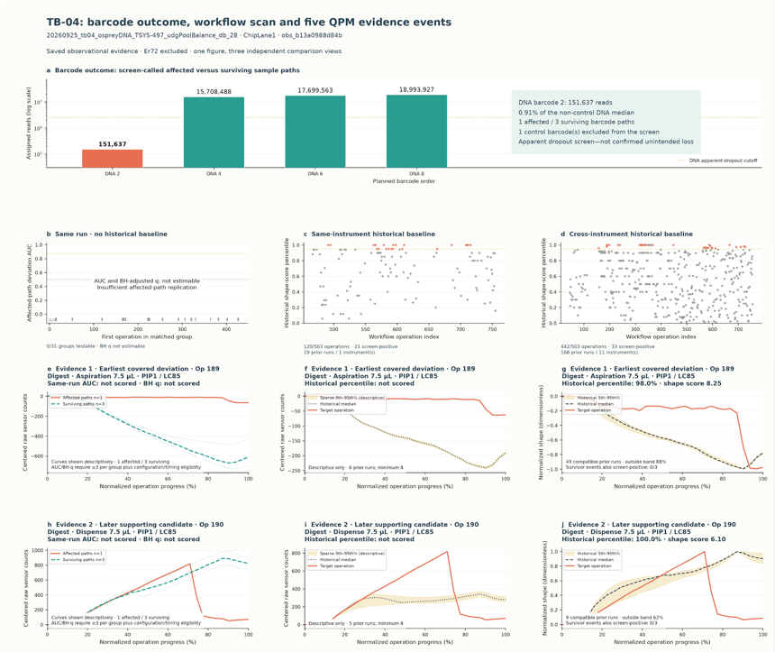
QPM SENTINEL / RESULTS & PROTOTYPE
From CSA to
a complete report
TB-04 · complete provided report snapshot
Five workflow steps. Full report.
1 · Read CSA
Outcomes, logs and metadata
Same run
Same instrument
Cross-instrument
2 · Screen
DNA / RNA flags · chip / lane reads
3 · Map steps
Barcode paths · workflow commands
4 · Compare
Earliest
covered
evidence
Same run + same-instrument history
Separate cross-instrument reference
5 · Report
Earliest covered deviation
+ later supporting evidence
Later
support
Complete supplied image retained · QPM response is not measured delivered volume · Yan Zhu · 5 November 2026
Notes:
The user explicitly requested the entire provided report and all five workflow blocks on one slide. The five blocks are editable native PowerPoint shapes/text. The right-hand figure retains the complete provided report: barcode outcome, all three workflow scans and all six displayed aspiration/dispense comparison panels. The plot is a native picture viewport, not redrawn or rescored. We use the same report from the earlier higher-resolution screenshot to avoid another downsampling step. Both uploads are preserved. The header says five evidence events, but the supplied image shows two evidence rows; we do not invent the three unshown rows. This is the complete PROVIDED image, not a claim that this snapshot contains the entire original HTML report. Same-run curves involve one affected and three surviving paths and are descriptive, not a formal inferential AUC. Op189 is earliest covered Digest 7.5 µL aspiration/PIP1/LC85; Op190 is a later supporting 7.5 µL dispense. Neither is a proven initial cause. All three reference views remain visible and distinct. The same-instrument Op189 history has six compatible runs, below the eight-run scoring minimum. Raw QPM response is not calibrated delivered volume. Dense report text is source-resolution-limited on a 16:9 overview; use the separately supplied three zoom backup slides or report reading copy for detailed discussion. No data, models, scoring thresholds, historical references, plugin code or previous artifacts have been changed. Large native column labels identify Same run, Same instrument and Cross-instrument. Outside-margin badges identify Earliest covered evidence (not causal) and Later support. Only redundant tiny column headings are overlaid; no plotted values, traces or statistics are covered.
Evidence sources:
/rhome/yanzhu/.codex/attachments/06832121-ec50-40d9-bad3-cc72e9a90a0b/codex-clipboard-7187cd4f-7480-4e22-b1ff-bfd5cc929dce.png
/rhome/yanzhu/.codex/attachments/753f74c2-9094-49eb-9f26-272c54eb6444/codex-clipboard-8bd1f40c-4f53-4207-a378-e97edd470cef.png

Slide 7
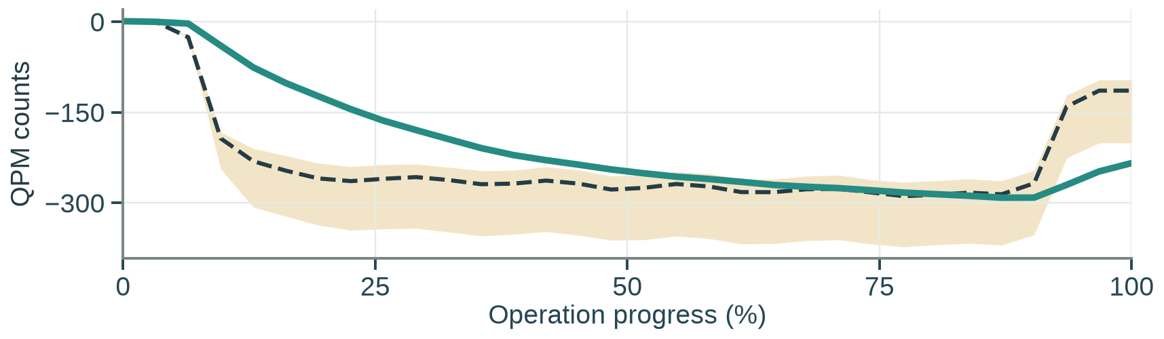
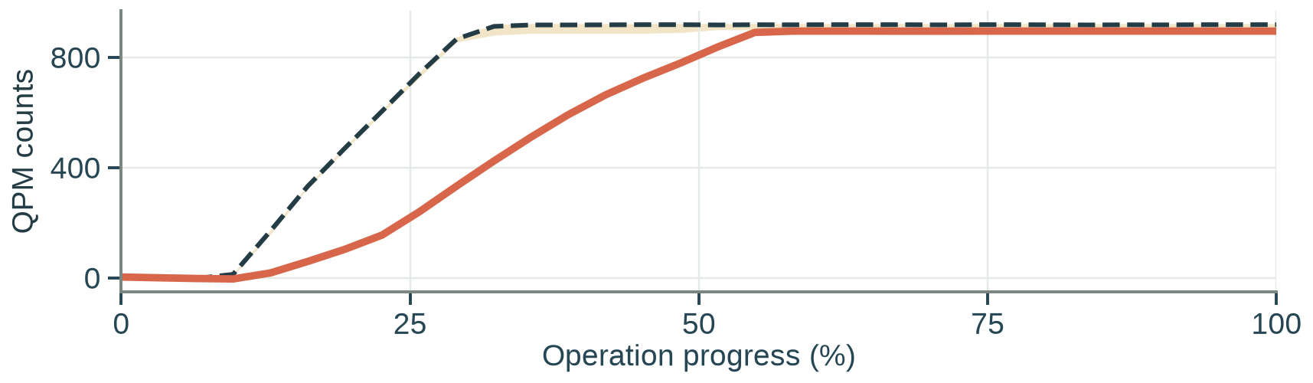
QPM SENTINEL / RESULTS & PROTOTYPE
QPM ML: benchmark and volume-signature example
Unseen-instrument classification benchmark + a separate, real-operation regression example
a Commanded-volume model comparison
b–c Separate regression example
PIP2 · 450 physical runs per task · 43 instruments · 5 classes per row
GNXS-0083 · 22 Oct 2026 · PIP2 / LC61 · Extra Trees
b Aspiration: 100 → 82.79 µL nominal-equivalent
LC49 · aspiration
5,38,45,50,60 µL
20.0
55.5
52.4
70.5
69.4
56.4
70.4
70.2
NaOH cycle 3 · Δ -17.21 µL · MAE 12.55 µL
LC49 · dispense
6,29,35,38,50 µL
20.0
58.8
68.4
80.0
78.7
73.5
80.9
80.8
Under delivery
LC55 · aspiration
25,50,70,72,100 µL
20.0
54.4
54.8
75.5
77.6
70.2
72.5
77.6
LC55 · dispense
33,60,72,90,99 µL
20.6
73.8
46.0
79.8
80.5
68.7
83.3
83.3
LC61 · aspiration
20,50,60,66,300 µL
20.1
76.2
59.1
81.9
84.7
59.1
82.0
84.9
c Dispense: 70 → 105.43 µL nominal-equivalent
LC61 · dispense
50,60,69,200,250 µL
Chip coupler D1 · Δ +35.43 µL · MAE 15.07 µL
21.1
76.4
76.2
86.4
84.8
70.0
85.0
84.9
Majority
Context
only
Robust
template
Logistic
Linear
SVM
PCA +
logistic
Extra
Trees
Nested
selected
Over delivery
Balanced accuracy (%)
0
20
40
60
80
100
Cells = mean balanced accuracy across held-out-instrument folds.
Target
Ref. median
5th–95th% · n=9
QPM Sentinel · Yan Zhu · 5 Nov 2026 | Case analysis is retrospective; both operations are later anomalies, not proven causes.
Notes:
60–90 seconds. The left panel preserves the six-task / eight-model classification benchmark exactly, including all 48 balanced-accuracy values, model order and five commanded volume classes per task. Scores are arithmetic means across held-out-instrument folds, not pooled accuracy; physical runs have equal weighting within each fold. PIP2, 450 physical runs per task and 43 instruments are recorded in cohorts.csv. The 450 runs overlap across tasks and must not be summed as independent runs. The right panel is a SEPARATE all-operation regression deployment case. Its LC61 100 µL aspiration and 70 µL dispense commands are NOT among the left LC61 classification levels, so the heatmap accuracy does not validate these continuous estimates. Registered Extra Trees nominal-equivalents are 82.792372 and 105.429636 µL, task MAEs 12.548160 and 15.071320 µL; these are not calibrated measured delivery, under/over-transfer amounts or individual uncertainty intervals. Native baseline-centered waveform and same-instrument reference bands come from saved numerical data; each reference has nine physical runs. The target was excluded from model training, but model/reference use is retrospective and can include later history. Both displayed operations are later historical anomalies, not the earliest selected causal step. The 100 µL and 70 µL commands intentionally differ; do not mass-balance predictions. All original results and decks remain untouched.
Evidence sources:
/rhome/yanzhu/ML_CSA/genexus_csa_project/nature_findings_publication_20261031/source_data/six_task_classification_heatmap.csv
/rhome/yanzhu/ML_CSA/genexus_csa_project/qpm_volume_models_expanded_20261027_gx8_v2/cohorts.csv
/rhome/yanzhu/ML_CSA/genexus_csa_project/presentation_updates_20261104/QPM_nominal_volume_case_source_data.csv
/rhome/yanzhu/ML_CSA/genexus_csa_project/presentation_updates_20261104/QPM_nominal_volume_case_provenance.json

Slide 8
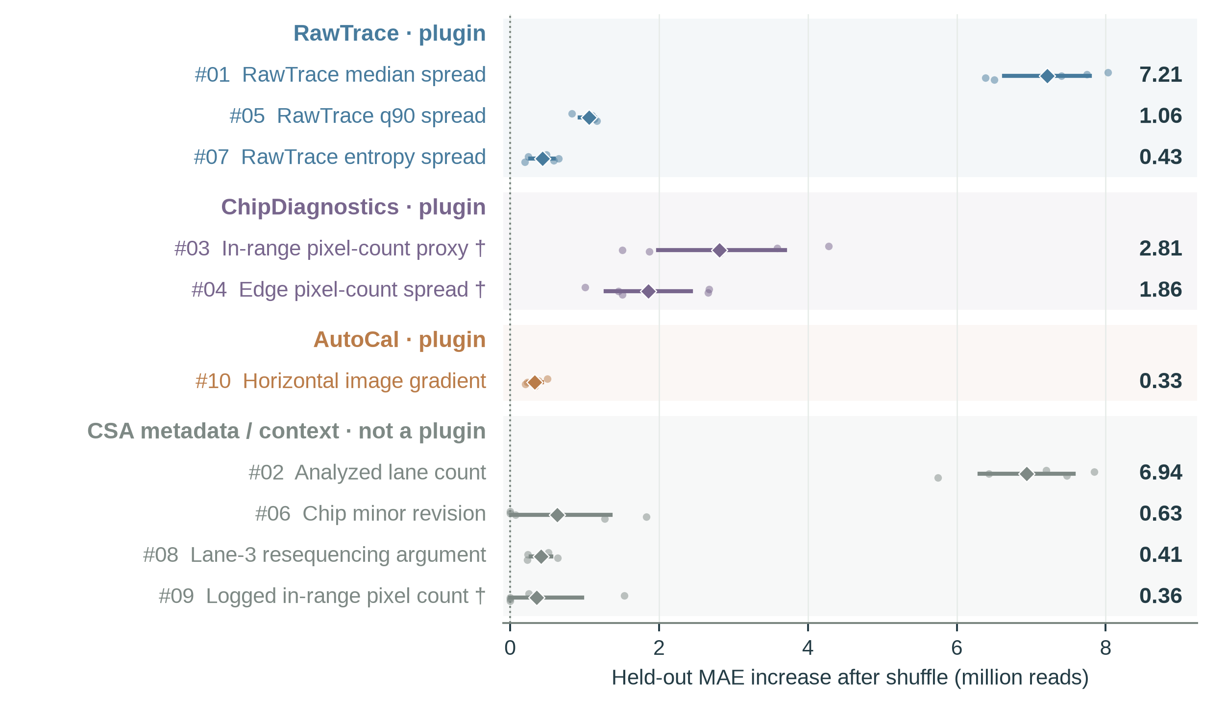
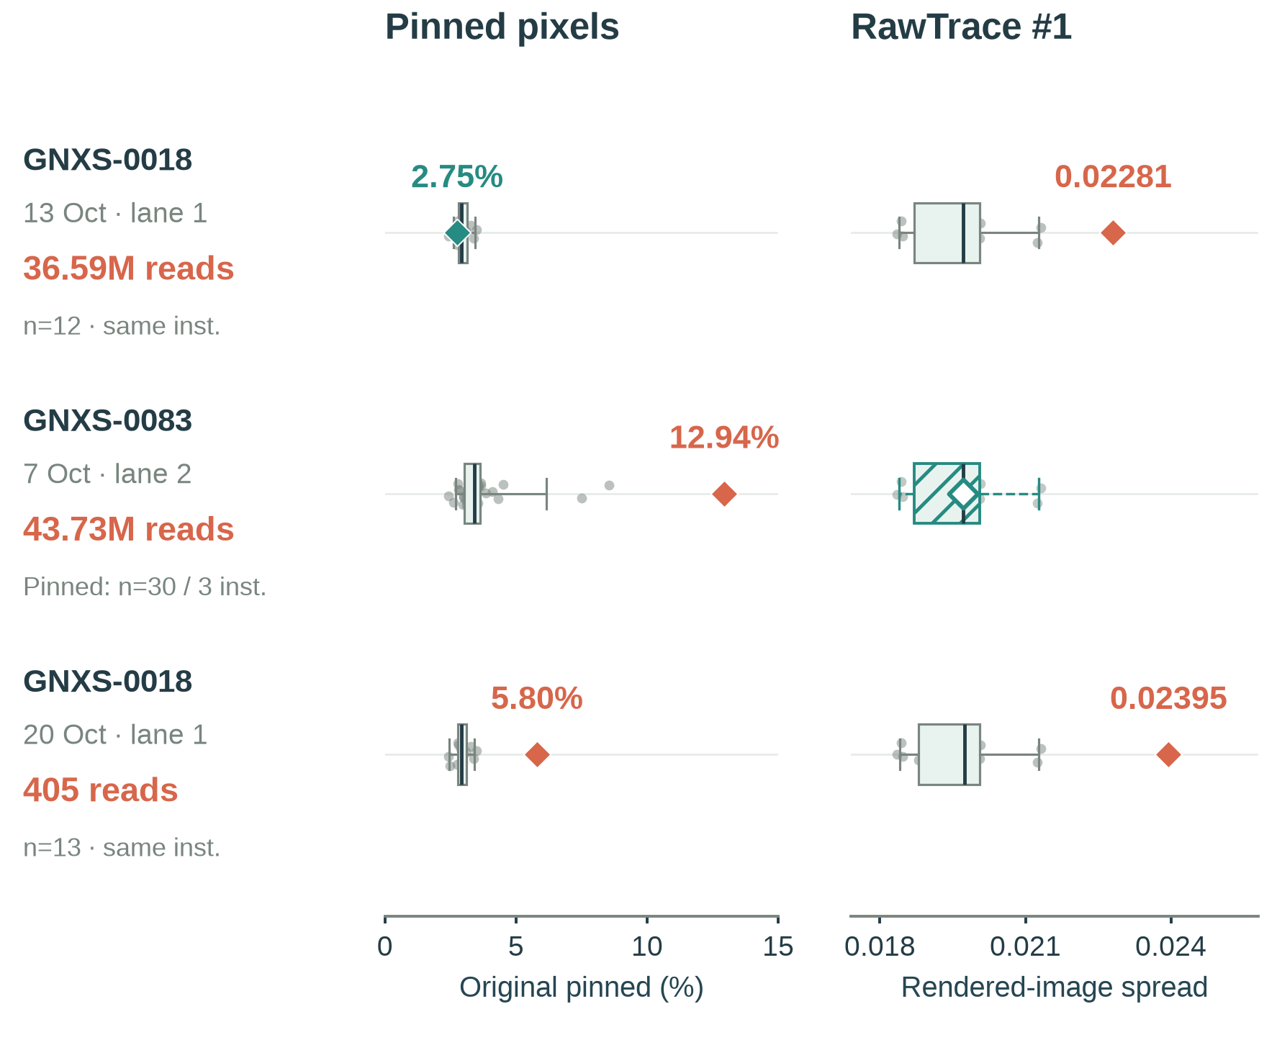
QPM SENTINEL / RESULTS & PROTOTYPE
CSA plugin metrics ML: illustrative diagnostic patterns
Global model rankings prioritize review; compatible prior peers reveal different run-specific patterns.
a Top 10 CSA Plugin Metrics Influencing Run Performance
b Low reads can have different clues
Physical-run-grouped Elastic Net · five held-out folds
Investigation hypotheses · one illustrative RawTrace cell*
Nuc/Salt issue
Chip issue
Both
Dots: held-out folds · lines: exploratory 95% intervals · diamonds: means
Peer IQR / exact 5th–95th%
Outside range
Within range
† Count/geometry health interpretation withheld; pinned % is separate validated evidence. RawTrace is an image proxy; input conditions unverified. | Yan Zhu · 5 Nov 2026
Notes:
STYLE-ONLY LABEL UPDATE. The requested Nuc/Salt issue, Chip issue and Both labels are user-proposed illustrative INVESTIGATION HYPOTHESES, not validated diagnoses or model outputs. RawTrace is a rendered-image descriptor and does not specifically establish a nucleotide/salt fault. A high pinned percentage does not by itself prove a chip defect. 'Both' means review both evidence families, not proven dual root causes. The middle run's actual RawTrace is missing; the illustrative box cannot establish a chip-only cause or normal RawTrace. Badges use the same font/size/alignment and muted source-matched colors; they do not alter measurements, references, rankings or model results.
ILLUSTRATIVE PRESENTATION VARIANT. Only the GNXS-0083 RawTrace cell is changed visually. The real run has no RawTrace measurement. The displayed hatched box borrows the 12-run reference distribution used for GNXS-0018 13 October, and the hollow target marker is hypothetically placed at that distribution's median. This distribution is NOT established as compatible or prior for GNXS-0083; some source runs postdate its 7 October start. Do not use this drawing for analysis or claim that the run's RawTrace was normal. The n=30 / three-instrument label refers only to the unchanged pinned-pixel comparison. All recorded target values, missing-data states, source tables, models, reports and the original factual slide remain unchanged.
60–90 seconds. The left panel is a global, fixed top-ten individual-feature ranking from five physical-run-grouped held-out Elastic Net folds; colors and headings group provenance, not summed plugin importance. Original global ranks, means, exploratory outer-fold intervals and all 50 saved fold points are preserved. Importance is the increase in prediction MAE when a feature is shuffled—not a causal effect or an amount of reads lost. Correlated metrics may split or mask importance. Lane count is adjustment context, not a fault mechanism. Daggered ranks 3, 4 and 9 are count/geometry proxies, withheld as chip-health or loading measurements. The right panel contains three separate GX9 single-analyzed-lane observations below the user-defined 50M criterion. GNXS-0018 13 October lane1: 36.591511M reads, original pinned 2.7532577% inside the 12-prior-same-instrument empirical range; RawTrace median spread .02280994 is high. GNXS-0083 7 October lane2: 43.734654M reads, pinned 12.9447151% high against 30 earlier qualified runs across three other instruments; RawTrace is missing and unresolved, never silently normal. GNXS-0018 20 October lane1: 405 reads, pinned 5.7978495% and RawTrace .02395201 both high against 13 earlier same-instrument physical runs. Every peer contributes one physical-run vote; boxes are IQR and whiskers exact empirical 5th/95th percentiles, not confidence intervals or approved acceptance limits. Original pinned percentage has a validated denominator and is SUPPLEMENTAL chip evidence, not the merged count proxy ranked #3 or the edge count proxy ranked #4. RawTrace is a rendered-image luminance descriptor, not calibrated signal amplitude or SNR. No root cause, read loss, tuning effect or input equivalence is established by these comparisons. All original slides, figures, reports and models are unchanged.
Evidence sources:
/rhome/yanzhu/ML_CSA/genexus_csa_project/presentation_updates_20261104/read_metrics_by_plugin_source_data.csv
/rhome/yanzhu/ML_CSA/genexus_csa_project/presentation_updates_20261104/read_metrics_by_plugin_fold_points.csv
/rhome/yanzhu/ML_CSA/genexus_csa_project/chip_rawtrace_visuals_20261103/plotted_case_metrics.csv
/rhome/yanzhu/ML_CSA/genexus_csa_project/chip_rawtrace_visuals_20261103/plotted_peer_votes.csv

Slide 9
Conclusions
Demonstrated a scalable, explainable approach for turning archived instrument data into structured NGS troubleshooting evidence.
The strongest current value is retrospective fault localization and investigation prioritization, not proven causality or automatic instrument optimization.
Pilot within Genexus/Thunderbolt workflows; measure investigation time, escalation rates, diagnostic agreement and repeat-run costs.
Expand across CSD products only after telemetry compatibility and product-specific validation, maintaining privacy, auditability and expert oversight.

Slide 10
Thank you!

